Slide 1

Title of the paper: Exploring the Impact of Explainability
in Large Language Model (LLM) Applications on User Experience
Authors:
Yanyun Wang, Xumei Fang, Zan Xu, Jianye Li, Luping Wang
Supervised By:
Dr. Muhammad Firoz Mridha
Presented By:
Rifah Sanzida(22-47154-1)

Slide 2


Table of Contents
Slide No. | Section Title
01 | Summary of the Study
02 | Summary of the Study (Cont.)
03 | Key Contributions & Findings
04 | Methodology
05 | Experimental Procedure (Figure)
06 | Study Design
07 | Variables and Procedures
08 | Limitations
09 | Proposed Improvements
10 | Future Research Directions
11 | References

Slide 3
Summary of the Study
Research Goals:
Evaluate the impact of explainability on user trust and satisfaction in LLM-based chatbots.
Compare effects across risk levels: Low-risk (e.g., weather) vs. high-risk (e.g., medical queries).
Test different explainability formats (e.g., reasoning steps, reference sources).
Analyze the correlation between trust and satisfaction.
Participants:
32 experienced users (ages 25–35) from Zhejiang, China.
All used LLMs (e.g., chatbots) regularly.
01

Slide 4
Summary of the Study(Cont.)
Key Findings: Provenance (source info) significantly increased both trust and satisfaction. Too much detail (e.g., reasoning steps + details) lowered satisfaction in low-risk scenarios. Users preferred clear, concise answers in simple contexts. In high-risk scenarios, users valued detailed explanations more. Trust and satisfaction are positively correlated (r = 0.451, p < 0.05). Limitations: Participants were demographically narrow (young, Chinese, experienced users). Only two scenarios tested; generalizability is limited. Lacked real-time interaction and multimodal content.
02

Slide 5
Key Contributions & Findings
Empirical Evidence: Demonstrated that explainability methods significantly impact user trust and satisfaction in LLM applications.
Context Matters:
In low-risk scenarios, users preferred brief, direct answers.
In high-risk scenarios, users valued detailed explanations more.
Balance Needed: Too much explanation (e.g., reasoning steps + details) reduced satisfaction in simple tasks due to information overload.
Trust ↔ Satisfaction: Identified a positive correlation between trust and satisfaction (r = 0.451, p < 0.05).
Design Insight: Suggested that LLM interfaces should use adaptive, user-sensitive explainability strategies rather than a one-size-fits-all model.
4

Slide 6
Experimental Procedure(Figure)
Methodology
Study Design
Variables & Procedure
04

Slide 7

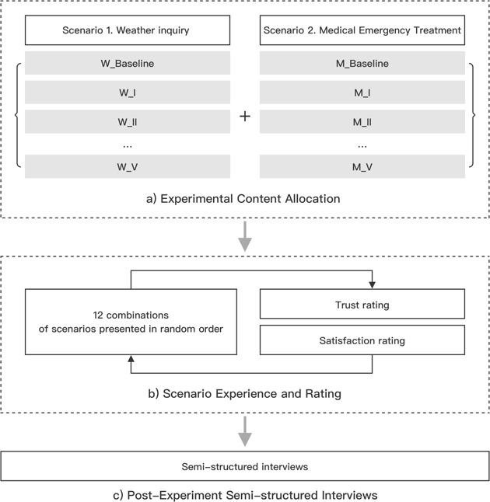

Methodology
Experimental Procedure
Figure: Experimental Procedure
05

Slide 8
Participants
32 experienced LLM users (ages 25–35) from Zhejiang, China.
All had used chatbots 3+ times per week in the past month.
Balanced gender distribution (16 male, 16 female).
Ethics & Consent
Informed consent obtained; participation was voluntary.
Data collected anonymously, with no personal identifiers.
Experimental Setup
Participants viewed 12 pre-recorded chatbot dialogues.
Two scenarios used:
Low-risk: Weather inquiry
High-risk: Medical emergency
Responses were generated using Qwen2-72B LLM.
Methodology
Study Design
06

Slide 9
Explainability Variables Six experimental conditions based on output type:
Baseline (No Explanation) ➤ The chatbot provides only the final answer, with no insight into how or why it arrived at it. Used as a control group.
Steps ➤ Shows the logical steps or process the LLM followed to reach its answer—but without extra detail.
Steps + Details ➤ Includes both the logical steps and specific details that explain the model’s thought process in depth.
Provenance ➤ Adds source references or external evidence (e.g., websites, documents) used to support the answer.
Steps + Provenance ➤ Combines reasoning steps with source references, helping users see both the process and where the info came from.
Steps + Details + Provenance ➤ Offers the most complete explanation—logical steps, detailed reasoning, and source references all together.
Methodology
Variables & Procedure
07

Slide 10
Limitations
Narrow Participant Demographic ➤ Only included users aged 25–35 from Zhejiang, China—limits generalizability.
Limited Scenario Diversity ➤ Only tested two cases (weather & medical)—other real-world contexts (e.g., education, finance) not explored.
No Real-Time Interaction ➤ Used pre-recorded videos instead of live chatbot sessions—may not reflect natural user behavior.
Text-Only Interface ➤ Study excluded multimodal elements (e.g., visuals, voice), which are common in modern LLM apps.
Controlled Environment ➤ Experimental setup minimized external variables but lacked spontaneity and interface variability
08

Slide 11

Proposed Improvements
Broaden Participant Diversity
Include users from varied age groups, regions, and tech backgrounds.
Study first-time or non-expert users to understand general public experience.
Expand Scenario Variety
Add more real-world contexts such as:
Education (e.g., tutoring)
Law (e.g., contract drafting)
Travel, food, shopping, etc.
Use Real-Time Interactions
Replace pre-recorded videos with live chatbot sessions to reflect authentic usage and spontaneous feedback.
Incorporate Multimodal Interfaces
Include LLMs that use visuals, voice, charts, or GUI elements for a more realistic user experience.
09

Slide 12
Future Research Directions
Adaptive Explainability Systems
Develop personalized explainability based on user needs, background, or risk level.
Explore More UX Dimensions
Beyond trust & satisfaction, measure:
Cognitive load
Confidence in decision-making
Emotional response
Investigate Ethical Implications
Examine the impact of explainability on:
Overtrust or blind reliance
Misleading information sources
Perceived fairness or bias
Longitudinal Studies
Assess how user perceptions evolve over long-term use of LLMs with and without explainability.
10

Slide 13
References
Finale Doshi-Velez, Been Kim. 2017. Towards a rigorous science of interpretable machine learning. arXiv preprint arXiv:1702.08608 (Mar 2017). https://doi.org/10. 48550/arXiv.1702.08608
Hovy Dirk, Shannon L. Spruit. 2016. The social impact of natural language processing. In Proceedings of the 54th Annual Meeting of the Association for Computational Linguistics (Volume 2: Short Papers). ACL, Berlin, Germany, 591-598. https://doi.org/10.18653/v1/P16-2096
Haoran Li, Yulin Chen, Jinglong Luo, Jiecong Wang, Hao Peng, Yan Kang, Xiaojin Zhang, Qi Hu, Chunkit Chan, Zenglin Xu, Bryan Hooi, Yangqiu Song. 2023. Privacy in large language models: Attacks, defenses, and future directions. arXiv preprint arXiv:2310.10383 (Oct 2023). https://doi.org/10.48550/arXiv.2310.10383
Mohammad Al-Rubaie, John M. Chang. 2019. Privacy-preserving Machine Learn- ing: Threats and Solutions. IEEE Security & Privacy 17,2 (March 2019), 49-58. https://doi.org/10.1109/MSEC.2018.2888775
Emma Strubell, Ananya Ganesh, Andrew McCallum. 2019. Energy and Policy Con- siderations for Deep Learning in NLP. In Proceedings of the 57th Annual Meeting of the Association for Computational Linguistics. Association for Computational Linguistics, Florence, Italy, 3645–3650. https://doi.org/10.18653/v1/P19-1355
11

Slide 14


Thank You
for your attention
12

